Slide 1
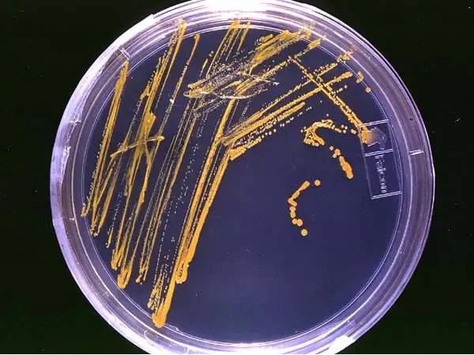

CULTURE
MEDIA AND
CULTURE
METHODS
By
Dr Syed Ayesha Fatema
Professor
PG Dept Of Medicine
ZVMUMCH Pune Maharashtra India

Slide 2
CULTURE
MEDIA

Slide 3
INTRODUCTION
A culture media is a special medium used in microbiological laboratories to grow different kinds of microorganisms.
A growth or a culture medium is composed of different nutrients that are essential for microbial growth.
Since there are many types of microorganisms, each having unique properties and requiring specific nutrients for growth, there are many types based on what nutrients they contain and what function they play in the growth of microorganisms.
A culture may be solid or liquid.
The solid culture media is composed of a brown jelly like substance known as agar.
Different nutrients and chemicals are added to it to allow the growth of different microorganisms.

Slide 4
Growing bacteria in pure culture is still one of the most widely used methods in microbiology.
Many bacteria, particularly those that cause diseases and those used in scientific studies, are heterotrophic, which means that they rely on organic compounds as food, to provide energy and carbon.
Some bacteria also require added nutritional components such as vitamins in their diet.
An appropriate physical environment must be created, where important factors such as temperature, pH, and the concentration of atmospheric gases (particularly oxygen) are controlled and maintained.

Slide 5
The nutritional needs of bacteria can be met through specialized microbiological media that typically contain extracts of proteins (as a source of carbon and nitrogen), inorganic salts such as potassium phosphate or sodium sulfate, and in some cases, carbohydrates such as glucose or lactose.
For fastidious bacteria (meaning, those that are picky eaters) vitamins and/or other growth factors must be added as well.

Slide 6
Koch, Pasteur, and their colleagues in the 19th and early 20th centuries created media formulations that contained cow brains, potatoes, hay, and all sorts of other enticing microbial edibles.
Today, bacteriological media formulations can be purchased in powdered form, so that all the preparer has to do is to measure out the correct amount, add the right amount of water, and mix.
After the basic formula has been prepared, the medium is sterilized in an autoclave, which produces steam under pressure and achieves temperatures above boiling.
Once sterilized media has cooled, it is ready to be used.

Slide 7
Culture media are required to grow the organisms from infected material, to identify the causative agent.
The basic constituents of culture media are:
1. Water: Source of hydrogen and oxygen.
2. Electrolyte: Sodium chloride or other electrolytes.

Slide 8
3. Peptone: It is a complex mixture of partially digested proteins.
  It is obtained from lean meat or other protein material such as heart muscle, casein or fibrin, usually by digestion with proteolytic enzymes.
  It contains proteoses, amino-acids, polypeptides, phosphates, minerals (K, Mg), and accessary growth factors like nicotinic acid and riboflavin.
  Special brands of peptone such as neopeptone, proteose peptone are available for special uses.

Slide 9
4. Meat extract: It is available commercially as Labr-Lemco. It contains protein degradation products, inorganic salts, carbohydrates and growth factors.
5. Blood or serum:
  These are used for enriching culture media.
  Usually 5-10% defibrinated sheep blood is used. In certain media, serum is used.

Slide 10
6. Agar:
  It is prepared from sea weed (Algae- geladium es).
  It contains mainly long-chain polysaccharide, a small amount of protein-like material and a variety of inorganic salts.
  It is available either in long shreds or powder form.
  It is used in concentration of 2-3%.
  It melts at 98°C and usually solidifies at 42°C.
  Agar does not provide any nutrition to the bacteria but acts as a solidifying agent only.
  New Zealand agar has twice the jellifying capacity than that of Japanese agar.

Slide 11
TYPES OF CULTURE MEDIA
Media are classified in many ways:
1. Based on physical state
(i) Liquid media
(ii) Semisolid media
(iii) Solid media
2. On the basis of presence of molecular oxygen and
reducing substances in the media
(i) Aerobic media
(ii) Anaerobic media
3. Based on nutritional factors
(i) Simple media
(ii) Complex media
(iii) Synthetic media
(iv) Special media
(a) Enriched media
(b) Enrichment media
( c) Selective media
(d) Differential media
(e) Indicator media
(j) Transport media
(g) Sugar media

Slide 12
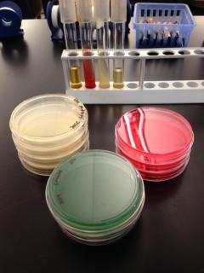
Based on physical state Liquid media, Semisolid media and Solid media
Bacteriological culture media can be prepared as a
  liquid (broth),
  a solid (plate media or slant media), or
  as a semi-solid (deeps)
  as illustrated in Figure .

Slide 13
Solid and semi-solid media contain a solidifying agent such as agar or gelatin.
Agar, which is a polysaccharide derived from red seaweed (Rhodophyceae) is preferred because it is an inert, non-nutritive substance.
The agar provides a solid growth surface for the bacteria, upon which bacteria reproduce until the distinctive lumps of cells that we call colonies form.

Slide 14
Based on nutritional factors
1. Simple Media
Nutrient broth is an example of simple medium.
It contains peptone water and meat extract 1 %.
When glucose (0.5%) is added to nutrient broth, it becomes glucose broth.
Peptone water and glucose broth are shown in Figs. 5.1 and 5.2.

Slide 15
When 2-3% agar is added to nutrient broth, it becomes nutrient agar
This is the simplest and routinely employed medium in laboratory for diagnostic purposes.
If concentration of agar is reduced (0.2 to 0.4%), semisolid medium is obtained which enables motile bacteria to spread.

Slide 16
2. Complex Media
All media other than simple media are complex.
Complex media have added ingredients for bringing out certain properties or providing special nutrients required for the growth of the bacterium in question.

Slide 17
3. Synthetic Media
These are prepared from pure chemicals and the exact composition of the medium is known.
These are used for special studies such as metabolic requirements.
Dubo's medium with tween 80 is one example of a synthetic medium.

Slide 18
4. Special Media
(a) Enriched Media
When basal medium is added with some nutrients such as blood, serum or egg, it is called enriched medium.
Some examples of enriched media are:
  Blood agar (Fig. 5.4) - Blood is added to nutrient agar.
  It may be used for growing a number of bacteria but one specific example is Streptococcus which requires blood for its growth.

Slide 19
  Chocolate agar (Fig. 5.5) - It is a heated blood agar used for isolation of Neisseria and Haemophilus_infiuenzae.

Slide 20
  Loeffier's serum slope (Fig. 5.6) –
    Serum is added for enriching the medium.
    This medium is used for grouping Corynebacterium diphtheriae.
    These media are employed to grow organisms which are more exacting in their nutritional needs.

Slide 21
(b) Enrichment Media :
Some substances are incorporated in the liquid medium which have a stimulating effect on the bacteria to be grown or inhibits its competitors.
This results in Its in an absolute increase in the number of wanted bacteria related to other bacteria.
Such media are called enrichment media.
These are very useful for culture of faeces where the nonpathogenic or commensal bacteria tend to overgrow the pathogenic ones, e.g., Salmonella being overgrown i by Esch. coli.

Slide 22
Some examples of enrichment media are as follows:
  Tetrathionate broth - Tetrathionate is added which inhibits coliforms while allows typhoid-paratyphoid bacilli to grow.
  Selenite 'F' broth - Selenite has similar action as that of tetrathionate in tetrathionate broth.
  'Alkaline peptone water - It is used to grow Vibrio cholerae.

Slide 23
(c) Selective Media:
Selective media contain substances that inhibit all but a few types of bacteria and facilitate the isolation of a particular species.
These media are used to isolate a particular bacteria from a specimen where mixed bacterial flora is expected.
Selective media are solid in contrast to enrichment media which are liquid.
Examples of selective media are:
  Deoxycholate citrate agar ( DCA) - Addition of deoxycholate acts as a selective agent for enteric bacilli (Salmonella, Shigella).
  Bile salt agar ( BSA) - Bile salt is a selective agent. It favours the growth of only Vibrio cholerae whereas inhibits the growth of other intestinal organisms.

Slide 24
(d) Differential Media
When a medium contains substances which help to distinguish differing characteristics of bacteria, it is called "differential medium"
e.g. MacConkey's medium, which contains
  peptone,
  lactose,
  agar,
  sodium taurocholate and
  neutral red.
The lactose fermenters (LF) form pink coloured colonies whereas non-lactose fermenters (NLF) produce colourless or pale colonies.

Slide 25
(e) Indicator Media
These media contain an indicator which changes colour when a bacterium grows in them.
Salmonella typhi grow as black colonies on Wilson and Blair medium containing sulphite.
MacConkey's agar (Fig. 5. 7) is also an indicator medium.
Due to fermentation of lactose, there is acidic pH which forms the pink colonies in the presence of neutral red indicator.
The blood agar is an enriched medium but bacteria lysing red blood cells give clearing (haemolysis) around their colonies, thus, it is also an indicator medium.
Therefore, some of these terms like indicator, differential, selective or enriched are interchangeable and more than one term may be applied for a single medium.

Slide 26
(f)Transport media:
These are used in the case of delicate organisms (e.g. gonococci) which may not survive the time taken for transit or may be overgrown by nonpathogenic bacteria (e.g. cholera organisms).
For transport of specimens to the laboratory, special media are devised and these are termed transport media.
Examples of transport media are:
  (a) Stuart's transport medium is a non-nutrient soft agar gel containing a reducing agent to prevent oxidation, and charcoal to neutralise bacterial inhibitors.
  It may be used for organisms such as gonococci.
  (b) Buffered glycerol saline transport medium for enteric bacilli.

Slide 27
(g) Sugar Media
Sugar media (Fig. 5.8) help in identification of bacteria. The term sugar in microbiology denotes any fermentable substance.
Glucose, lactose, sucrose and mannitol are routinely employed for fermentation tests.
Sugar media contain l % sugar in peptone water along with an indicator (Andrade's indicator--0.005% acid fuchsin in IN NaOH).
A small tube (Durham's tube) is kept inverted in the larger sugar tube to detect gas production.
The colourless medium turns pink with production of acid by bacteria and gas production is indicated by gas bubbles accumulated in Durham's tube.
Certain bacteria are exacting in their growth requirements and need serum for their growth e.g. Hiss's serum sugars for pneumococcus.

Slide 28
On the basis of presence of molecular oxygen and reducing substances in the media
ANAEROBIC MEDIA
These are used for cultivation of anaerobic bacteria e.g.
  (a) Cooked meat broth (CMB)
  (b) Thioglycollate broth.

Slide 29
MEDIA FOR TESTING SPECIAL PROPERTIES
Urea medium is used to test the property of urease production.
Phenylpyruvic acid (PPA) is employed for identification of Proteus sp.

Slide 30
Growing Bacteria in Culture
A population of bacteria grown in the laboratory is referred to as a culture.
A pure culture contains only one single type;
a mixed culture contains two or more different bacteria.
If a bacterial culture is left in the same media for too long, the cells use up the available nutrients, excrete toxic metabolites, and eventually the entire population will die.
Thus bacterial cultures must be periodically transferred, or subcultured, to new media to keep the bacterial population growing.

Slide 31
Microbiologists use subculturing techniques to grow and maintain bacterial cultures, to examine cultures for purity or morphology, or to determine the number of viable organisms.
In clinical laboratories, subculturing is used to obtain a pure culture of an infectious agent, and also for studies leading to the identification of the pathogen.
Because bacteria can live almost anywhere, subculturing steps must be performed aseptically, to ensure that unwanted bacterial or fungal contamination is kept out of an important culture.

Slide 32
To maintain an aseptic work environment, everything you work with should be initially free of microbes.
Thus, we begin with pre-sterilized pipettes, culture tubes, and glassware.
Inoculating loops and needles made of metal wire can be used to transfer bacteria from one medium to another, such as from the surface of an agar plate to a broth.
Metal tools may be sterilized by heating them in the flame of a Bunsen burner.
Glass tools or metal spreaders or forceps that can’t be sterilized by direct heat are dipped in alcohol followed by a brief pass through the flame to speed the evaporation process.
Standard aseptic techniques used for culturing bacteria will be demonstrated at the beginning of lab.

Slide 33
CULTURE
METHODS

Slide 34
INDICATION OF CULTURE MEDIA AND METHODS
In the clinical laboratory, bacterial cultures are indicated to
1. Isolate bacteria in pure culture from the clinical specimens and their identification by various tests,
2. determine antibiotic susceptibility,
3. prepare antigens for serodiagnosis of infective diseases,
4. maintain stock cultures.

Slide 35
I. METHODS OF CULTURE
A. Streak culture
B. Lawn culture
C. Stroke culture
D. Stab culture
E. Pour plate culture
F. Liquid culture

Slide 36
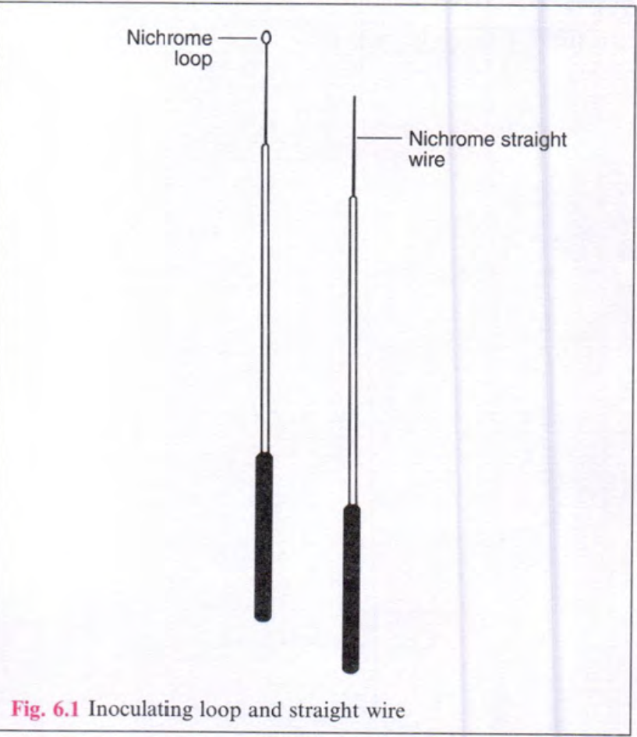
A . Streak Culture (Surface Plating)
It is the routine method employed for bacterial isolation in pure culture.
A platinum or nichrome wire loop of 2-4 mm internal diameter is used (Fig. 6.1) .

Slide 37
Due to high cost of platinum, loops for routine laboratory work are made of nichrome wire (24 S.WG. size).
This loop is first sterilised in the bunsen flame by making it red hot and cooled by touching an uninoculated part of the medium.
Then a loopful of specimen is smeared onto the surface of a dried plate near the peripheral area.
This is named as primary inoculum.

Slide 38
From the primary inoculum, it is spread thinly over the plate by streaking with the loop in parallel lines (Fig. 6.2).

Slide 39
The loop is flamed and cooled in between the different set of streaks.
It is done to obtain isolated colonies over the final series of streaks.
The culture plate is incubated at 37°C for overnight.
Confluent growth occurs at the primary inoculum and well separated colonies are obtained on the final streaks.
Single isolated colony is the best to study the various properties of bacteria.

Slide 40
B. Lawn Culture
This type of culture method is employed in antibiotic sensitivity testing ( disc diffusion method) and in bacteriophage typing.
It may also be employed for preparation of bacterial antigens and vaccines where a large amount of bacterial growth is required.
Lawn cultures are obtained by flooding the surface of the plate with a liquid culture or suspension of the bacterium.
Culture plate is kept for a minute and then excess material is poured off.
Alternatively, the culture plate may be inoculated by a sterile swab soaked in liquid bacterial culture or suspension.
Plate is then incubated at 37°C overnight to obtain bacterial colonies.

Slide 41
C. Stroke Culture
Stroke culture is done in tubes containing agar slope and is employed for providing a pure growth of the bacterium for slide agglutination and other diagnostic tests.
Commonly used agar slope is Nutrient agar slope.

Slide 42
D. Stab Culture
Stab culture is performed by a straight wire, charged with culture material (bacteria), by puncturing deep inside the agar.
This technique is employed to demonstrate gelatin liquefaction, oxygen requirement of the bacterium and to maintain stock cultures for preservation of bacteria.

Slide 43
E. Pour Plate Culture
Tubes containing 15 ml of agar medium in each are melted and kept to cool in a water bath at 45-50°C.
The inoculum to be tested is diluted in serial dilutions.
One ml of each diluted inoculum is added to each tube of molten agar, mixed well and the contents of the tube poured into a sterile petridish and allowed to solidify.
These plates are incubated at 37°C for overnight.
Colonies will be seen throughout the depth of the medium and can be counted using colony counter.
Uses
(a) To estimate viable bacterial count in a suspension.
(b) To quantitate bacteria in urine cultures.

Slide 44
F. Liquid Culture
Liquid cultures in test tubes, screw-capped bottles or flasks may be inoculated by touching with a charged loop or by adding the inoculum with pipettes or syringes.
This type of culture method is adopted for blood culture and for sterility tests, where the number of bacteria in the inocula are expected to be small.
Liquid cultures are preferable for specimens containing antibiotics and other antibacterial substances, as these become ineffective by dilution in the medium.
Liquid cultures are also preferred when large yields of bacteria are required.

Slide 45
Disadvantages
(a) It does not provide a pure culture from mixed inocula.
(b) Identification of bacteria is not possible.

Slide 46
Incubation of Culture Media
Most of the pathogenic organisms grow best at 37°C i.e. body temperature of human beings.
The inoculated culture media are incubated at 37°C in an incubator (Fig. 6.3).

Slide 47
II. ANAEROBIC CULTURE METHODS
Anaerobic bacteria grow only in the absence of oxygen (anaerobic conditions).
These anaerobic conditions or anaerobiosis can be established by various methods.

Slide 48
Methods of Anaerobiosis.
1. Production of a vacuum
2. Displacement of oxygen.
3. By displacement and combustion of oxygen.
4. Absorption of oxygen by chemical or biological
methods
5. By reducing agents
6. Anaerobic chamber.

Slide 49
1. Production of a Vacuum
1. Production of a Vacuum
Cultivation in vaccum was attempted by incubating cultures in a vaccum desiccator ,but it proved to be unsatisfactory.
This method is not in use now.

Slide 50
2. Displacement of Oxygen
2. Displacement of Oxygen
Displacement of oxygen by inert gases like hydrogen ,
nitrogen , carbon dioxide or helium is sometimes employed.
Oxygen can never be removed completely by this method.
A popular, but ineffective, method is the use of candle.
A lighted candle is kept in a large air-tight container loaded with inoculated plates.
It is expected that burning candle will use up all the oxygen inside before it is extinguished but some amount of oxygen is always left behind.

Slide 51
3. By Displacement and Combustion of Oxygen
3. By Displacement and Combustion of Oxygen
Anaerobiosis obtained by " McIntosh and Fildes” anaerobic jar (Fig. 6.4) is the most reliable and widely

Slide 52
Procedure
McIntosh and Filde's anaerobic jar consists of a stout glass or metal jar with a metal lid which can be clamped air-tight with a screw.
The lid is fitted with two tubes withtaps, one acting as inlet for introduction of gas and theother as the outlet.
The lid also contains two terminals which can be connected to an electrical supply.
A catalyst is suspended under the lid y stout wires which are connected with the terminals to heat the catalyst for its activity.
Nowadays catalyst (without heating) at room temperature is used.

Slide 53
Culture plates inoculated with specimens are placed inside the anaerobic jar with an indicator.
The lid is clamped tight.
The outlet tube is connected to a vacuum pump while inlet tube is closed.
The air inside is evacuated.
The outlet tube is then closed and hydrogen gas is passed through inlet tube till reduced atmospheric pressure is brought to normal atmospheric pressure (i.e. 760 mm Hg) which is monitored on the vacuum gauze as zero .
Electric terminals are switched on to heat the catalyst and if ' room temperature catalyst' is used, heating is not required.
The catalystst helps ta combine hydrogen and residual oxygen to form water.
Reduced methylene blue is generally used as indicator of anaerobiosis in the jar.
It remains colorless in anaerobic conditions, but turns blue on exposure to oxygen.

Slide 54
4. Absorption of Oxygen by Chemical or biological method
4. Absorption of Oxygen by Chemical or biological method
Chemical methods
  (i) Pyrogallol
  (ii) Chromium and sulphuric Acid
  (iii) Gas-pak
Biological methods

Slide 55
Chemical methods
(i) Pyrogallol
Alkaline pyrogallol absorbs oxygen.
This method was first introduced by Buchner (1888).
A large tube containing solution of sodium hydroxide and pyrogallic acid placed inside air-tight jar produces anaerobic conditions.

Slide 56
(ii) Chromium and sulphuric Acid
A mixture of chromium and sulphuric acid is used for producing anaerobiosis.
The two chemicals react in the presence of oxygen and produce chromous sulphate.

Slide 57
(iii) Gas-pak
It is-avaiiable commercially as a disposable packet containing pellets of sodium borohydrite, cobalt chloride, citric acid and sodium bicarbonate.
It is now widely used for preparing anaerobic jars.
These chemicals generate hydrogen and carbon dioxide when water is added.
Hydrogen combines with oxygen in the presence of a
catalyst.
After the inoculated plates are placed inside an air tight jar, the packet of " as-pa ' with water added, is kept inside and the lid is tightly closed.
The "Gas-pak“ technique is simple as compared to filling of gases by cylinders.

Slide 58
BIOLOGICAL METHODS
This has been attempted by incubating aerobic organisms along with anaerobic bacteria.
Two blood agar plates are taken -one is inoculated with Pseudomonas aeruginosa (aerobic bacteria) and the other with specimen of anaerobic bacteria.
Two plates are placed one over the other and sealed along the rims and are incubated.
This method is slow and ineffective

Slide 59
5. By Reducing Agents
5. By Reducing Agents
Oxygen in culture media can be reduced by various agents such as glucose, thioglycollate, cooked meat pieces, cysteine and ascorbic acid.
Based on this principle, the two most widely employed anaerobic liquid culture media are:
  THIOGLYCOLLATE BROTH /
    It contains nutrient broth and 1 % thioglycollate.
  COOKED MEAT BROTH (CMB) _
    It is also known as Robertson's cooked meat (RCM) medium.
    It contains nutrient broth and pieces of fat-free minced cooked meat of ox heart.

Slide 60
Principle
1. Unsaturated fatty acids present in meat utilise
oxygen for a auto oxidation, this reaction is catalysed by haematin in the meat.
2. Glutathione and cysteine (both are reducing agents) present in meat also utilize oxygen .
3. Sulphydryl compounds (present in cysteine) also contribute for a reduced oxidation-reduction (OR) potential.

Slide 61
Procedure
Before inoculation , the medium is boiled in water bath at 80°C for 30 minutes to make it oxygen free.
For strict anaerobiosis the surface of CMB medium may be covered with a layer of sterile liquid paraffin.
Interpretation
Saccharolytic anaerobes ( Cl. perfringens) turn the colour of meat pieces into red while it becomes black in case of proteolytic anaerobes ( Cl. tetani).

Slide 62
6. Anaerobic Chamber
6. Anaerobic Chamber
It is an anaerobic incubation system.
It provides oxygen-free environment for inoculating culture media and for their incubation.
It is fitted with airtight rubber gloves to insert hands for working with specimens.
These anaerobic chambers contain a catalyst, dessicant, hydrogen gas, carbon dioxide gas, nitrogen gas and an indicator.

Slide 63
BACTEC™ Automated Blood Culture System

Slide 64
The BD BACTEC™ Automated Blood Culture System
The BD BACTEC™ Automated Blood Culture System utilizes fluorescent technology in detecting the growth of organisms in the blood culture bottles.
When microorganisms are present in the cultured vials, they metabolize nutrients in the culture medium, releasing carbon dioxide into the medium.
A dye in the sensor at the bottom of the culture bottles will react with CO2.
This modulates the amount of light that is absorbed by a fluorescent material in the sensor.
The instrument’s photo detectors measure the level of fluorescence, which corresponds to the amount of CO2 released by the organisms.
Then the measurement is interpreted by the system according to preprogramed positivity algorithms.

Slide 65
The figure explains how the Fluorescent Technology works on the BACTEC™ systems

Slide 66
The uniqueness of BACTEC™ fluorescence sensor technology allows for fully-automated, walk-away testing using a continuous-monitoring instrument that agitates and incubates BACTEC blood culture bottles, resulting in earlier detection of positives blood culture.
The system also provides advance algorithms for each media types, for special circumstances such as low blood volume, pediatric specimens or to detect slow growing organisms such as Haemophilus and Neis-seria.
The algorithms provide rapid detection of pathogens in blood culture.

Slide 67
The combination of media-specific algorithms with growth phase-specific algorithms en-hances the sensitivity and time to detection, even in the case of delayed vial entry (≤48 hours if are not incubated or held at room temperature) and for bacteria that only generate limited amounts of carbon dioxide (e.g. Pseudomonas aeruginosa)

